Slide 1
University of Basrah
Al-Zahraa Medical College
Ministry of higher Education and Scientific Research
Academic year 2021-2022
5th year
REPRODUCTIVE BLOCK
Lecture : Normal and abnormal development of the female genital tract
Duration : 1 hour
Presented by
Dr. ABD ALKAREEM HUSSEIN SUBBER
Block staff:
Dr.Raya Muslim Al Hassan (Block leader)
Dr.Marwa Sadik (co leader)
Dr. Abdal kareem Hussain Subber
Dr.Alaa Hufdhi
Gynaecology by ten teacher 20th ed.
EDITION by Ten Teachers

Slide 2
University of Basrah
Al-Zahraa Medical College
Ministry of higher Education and Scientific Research
LEARNING OBJECTIVES
Understand that sexual differentiation and development begin in early embryonic life to neonate.
• Understand the embryonic development and the anatomy of the perineum, the
• Understand the vulnerability of certain structures in gynaecological surgery.
• Describe the structural anomalies resulting from Müllerian tract disorders.

Slide 3
University of Basrah
Al-Zahraa Medical College
Ministry of higher Education and Scientific Research
Sexual differentiation of the fetus and development of sexual organs.
Life starts male germ cell ( sperm ; XY chromosome ) fertilizes female germ cell ( ovum; XX chromosome) to form a zygote. Gender or sex determination begins at this time. The zygote divides into multiple cells and later forms an embryo. When embryo reach at 7 weeks called fetus
Up the 7th week of embryonic life, no sexual difference is seen in the fetus and differentiation of bipotential gonad into either ovaries or testes occurs after that. Followed by gonadal differentiation ( which is determined by chromosomal component of the zygote) , the internal genital tract and the external genitalia develop into male or female .

Slide 4
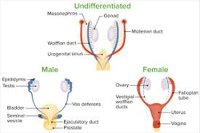
University of Basrah
Al-Zahraa Medical College
Ministry of higher Education and Scientific Research
At 4-5 wks of life urogenital ridge (precursors of the urinary and genital systems and the adrenal cortex ) is developed . At the 6th to 7th gestational weeks, the paramesonephric ducts (Mullerian ducts) develop next to the mesonephric ducts (Wolffian ducts). In males, Wolffian duct differentiates into the epididymis, vas deferens, and seminal vesicle. In females, the Mullerian duct differentiated into fallopian tubes, uterus, and upper part of the vagina

Slide 5
University of Basrah
Al-Zahraa Medical College
Ministry of higher Education and Scientific Research
Male
If an embryo is a genetic male (46 XY), the bipotential gonad differentiates to testes under the influence of the SRY gen, (sex-determining region of the Y chromosome)
The testis differentiates into two cell types of cells ;
The Sertoli cells produce (AMH) ( AnteMullerian Hormon) ------ suppress further development of the Müllerian ducts
The Leydig cells produce testosterone ------ 1) stimulate s the Wolffian ducts to develop into the vas deferens, epididymis and seminal vesicles ------2) converts to dihydrotestosterone in the external genital skin by 5-alpha-reductase which acts to virilize the external genitalia ( penis , scrotum and prostate ).

Slide 6
University of Basrah
Al-Zahraa Medical College
Ministry of higher Education and Scientific Research
Female
The female reproductive tract develops from Müllerian ducts in the absence of testicular AMH.
The paired Müllerian ducts, which grow in a caudal and medial direction and fuse in the midline. The midline fusion of these structures produces the uterus, cervix and upper vagina, and the Fallopian tubes.

Slide 7
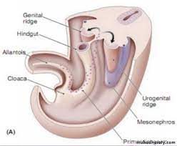
University of Basrah
Al-Zahraa Medical College
Ministry of higher Education and Scientific Research
The cloaca is the shared component of the anorectal and urogenital passages at the 5th week of gestation that subdivides into two separate channels during the 6th and 7th weeks.
The cloaca splits into the urogenital sinus anteriorly and the anal canal posteriorly. The urogenital sinus is a common channel into which both the urinary and genital tracts open.
The caudal extension of the Müllerian ducts projects into the posterior wall of the urogenital sinus as the Müllerian tubercle. The Müllerian tubercles and the urogenital sinus fuse to form the vaginal plate, which extends from the Müllerian ducts to the urogenital sinus. This plate begins to canalize, starting at the hymen creating the vagina and proceeding upwards to the cervix .

Slide 8
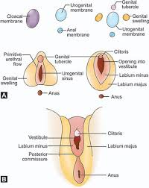
University of Basrah
Al-Zahraa Medical College
Ministry of higher Education and Scientific Research
Development of External Genital Organs in Females
Clitoris is developed from the genital tubercle.
Labia minora are developed from the genital folds.
Labia majora are developed from the genital swellings.
The Bartholin’s glands are developed from urogenital sinus .
The vestibule develops from the urogenital sinus

Slide 9
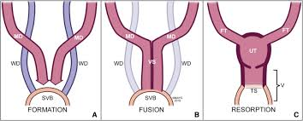
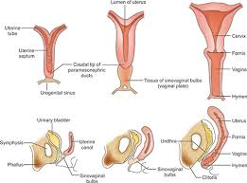
University of Basrah
Al-Zahraa Medical College
Ministry of higher Education and Scientific Research
Development of Internal Genital Organs
They develop from two Müllerian ducts one on either side and grow caudally and fuse in midline
Development of uterus
Uterus is developed by the fusion of Müllerian ducts, which begins at 7–8 wks and completes by 12th week
Development of Vagina
Upper 2/3rd from the Müllerian duct
Lower 1/3rd from the urogenital sinus
Canalization of the solid vaginal plate occurs at 20 weeks
((fails to occur it leads to – transverse vaginal septum))

Slide 10
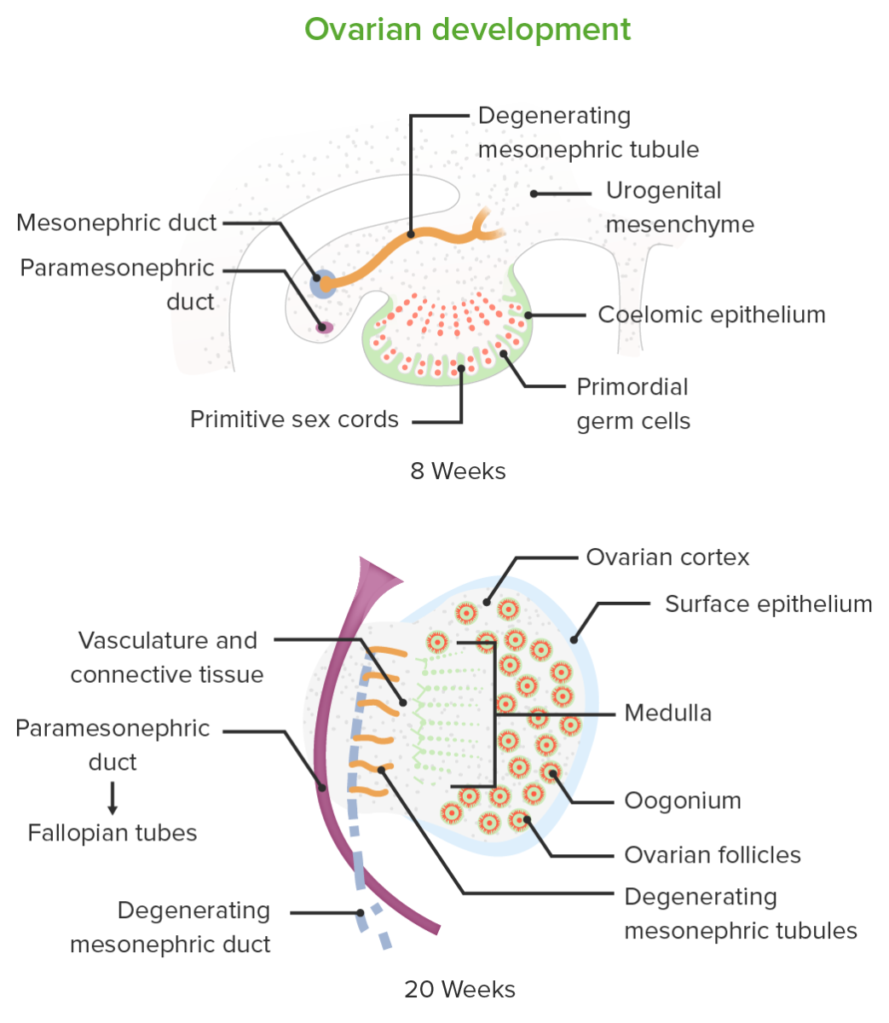
University of Basrah
Al-Zahraa Medical College
Ministry of higher Education and Scientific Research
Development of Ovary
Ovaries are formed by genital ridge but not from Müllerian ducts
For proper development of ovaries-presence of two X chromosomes is required; Thus if only one X chromosome is present it results in streak gonads like in Turners syndrome
The cortex and the covering epithelium are developed from the coelomic epithelium and the medulla from the mesenchyme. The germ cells are endodermal in origin and migrate from the yolk sac to the genital ridge.
The number of oogonia reaches its maximum at 20th wks is about 7 million. The estimated number at birth is about 2 million. Females are not capable of making new eggs, and in fact, there is a continuous decline in the total number of eggs each month. By the time a girl enters puberty, total egg pool remains, around 300,000

Slide 11
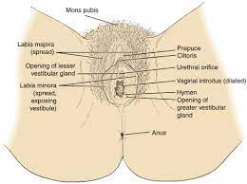
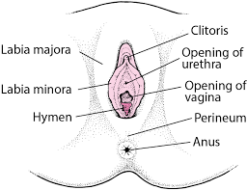
University of Basrah
Al-Zahraa Medical College
Ministry of higher Education and Scientific Research
Anatomy of female pelvic organs
External genitalia
External genitalia or vulva and includes the mons pubis, labia majora and minora, the vaginal vestibule, the clitoris and the greater vestibular glands.
The mons pubis is a fibro-fatty pad covered by hair-bearing skin that covers the bony pubic ramus.
The labia majora are two folds of skin with underlying adipose tissue lying either side of the vaginal opening.
They extend from the mons pubis downward and backward to merge with the skin of the perineum.
They contain sebaceous and sweat glands and a few specialized apocrine glands. In the deepest.

Slide 12
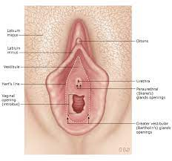
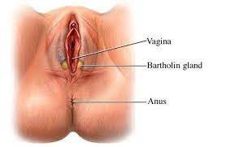
University of Basrah
Al-Zahraa Medical College
Ministry of higher Education and Scientific Research
The area between the labia minora is the vulva vestibule
The vulva vestibule contains the opening to the urethra
, Bartholin’s glands and the vaginal opening
The clitoris is an erectile structure measuring approximately 0.5–3.5 cm in length
The greater vestibular glands or Bartholin’s glands
bilateral and about the size of a pea. They open via a 2 cm duct into the =vestibule below the hymen and contribute to lubrication during intercourse

Slide 13
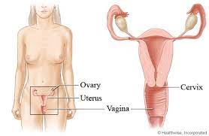
University of Basrah
Al-Zahraa Medical College
Ministry of higher Education and Scientific Research
The vagina
The vagina is a fibromuscular canal communicating the uterine cavity with the exterior at the valva . It is lined by stratified squamous epithelium.
It is longer in the posterior wall (9 cm) than in the anterior wall (7 cm) with a diameter of 2.5 cm. The vaginal walls are normally in apposition, except at the vault wherediameter v they are separated by the cervix. The vault of the vagina is divided into four fornices: posterior, anterior and two lateral.
The vagina has no glands and is kept moist by secretions
from the uterine and cervical glands and by transudation from its epithelial lining

Slide 14
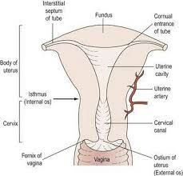
University of Basrah
Al-Zahraa Medical College
Ministry of higher Education and Scientific Research
The uterus
The uterus is a hollow pyriform muscular organ situated in the pelvis between the bladder in front and the rectum
Its maximum external dimensions are approximately 7.5 cm long, 5 cm wide and 3 cm thick. An adult uterus weighs approximately 70 g.
In the upper part, the uterus is termed the body or ‘corpus’. The area of insertion of each Fallopian tube is termed the ‘cornu’ and that part of the body above the cornu is called the ‘fundus. The uterus tapers to a small constricted area, the isthmus, and below this is the cervix, which projects obliquely into the vagina

Slide 15
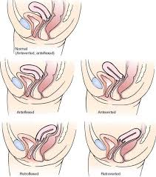
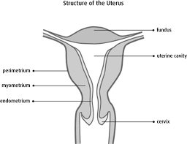
University of Basrah
Al-Zahraa Medical College
Ministry of higher Education and Scientific Research
The uterus
The longitudinal axis of the uterus is approximately at right angles to the vagina and normally tilts forward. This is called ‘anteversion. However, in around 20% of women, the uterus is tilted backwards – retroversion or retroflexion.
This has no pathological significance in most women, although retroversion that is fixed and immobile may be associated with endometriosisis or pelvic inflammatory disease.
The uterus consists of three layers: the outer serous layer (peritoneum), the middle muscular layer
(myometrium) and the inner mucous layer (endometrium).

Slide 16
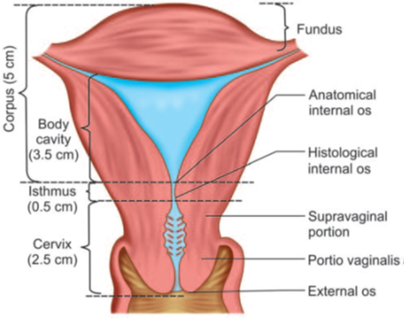
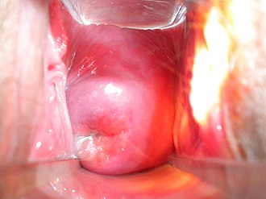
University of Basrah
Al-Zahraa Medical College
Ministry of higher Education and Scientific Research
The cervix
The cervix is narrower than the body of the uterus and is 2 to 3 cm long. The opening into the uterus is called the internal os and the opening into the vagina is called the external os. Lateral to the cervix lies cellular connective tissue called the parametrium. The ureter runs about 1 cm laterally to the supravaginal cervix within the parametrium.
The epithelium of the endocervix is columnar and is also ciliated in its upper two-thirds. This changes to stratified squamous epithelium around the region of the external os and the junction of these two types of epithelium is called the ‘squamocolumnar junction’

Slide 17
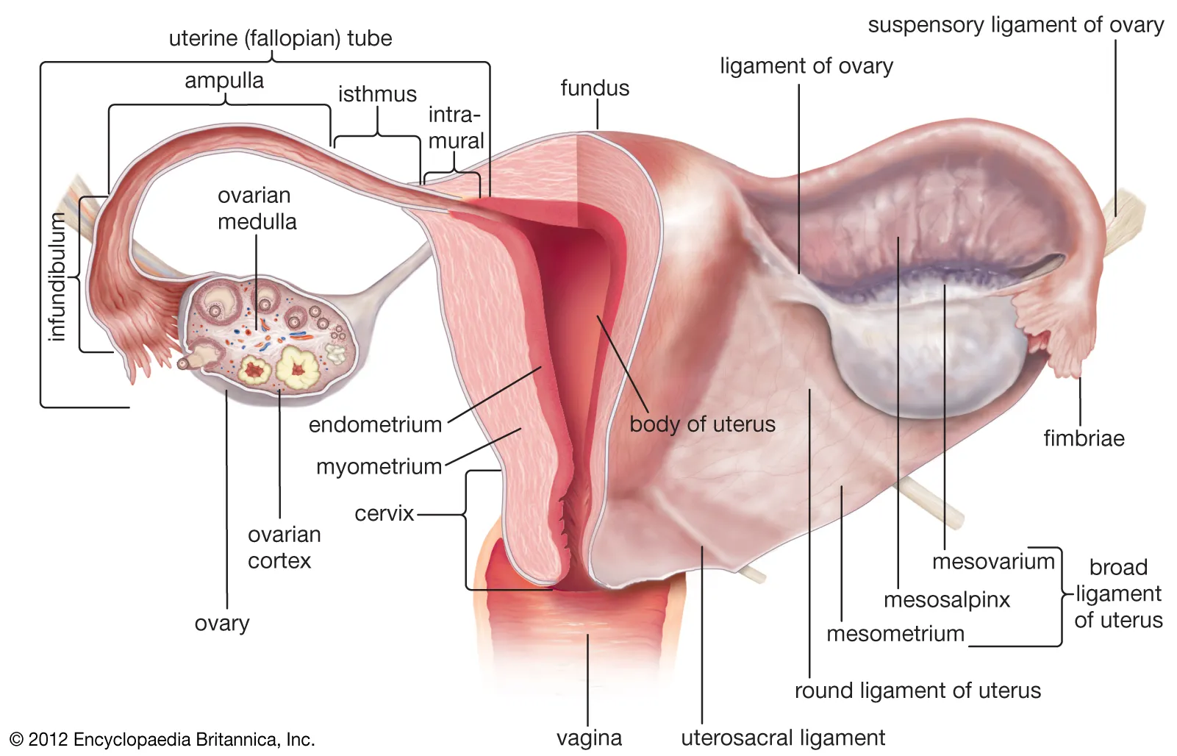
University of Basrah
Al-Zahraa Medical College
Ministry of higher Education and Scientific Research
The Fallopian tubes
The Fallopian tube extends outwards from the uterine cornu to end near the ovary.
The Fallopian tubes transport the ovum from the ovary to the uterus and promote oxygenation and nutrition for sperm, ovum and zygote if fertilization occur
Each tube is about 10 cm long and is described in
The interstitial portion.
The isthmus.
The ampulla.
The infundibulum or fimbrial portion

Slide 18
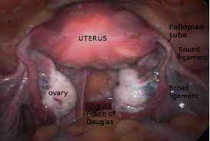
University of Basrah
Al-Zahraa Medical College
Ministry of higher Education and Scientific Research
The ovaries
They are almond -shaped and measure about 3 cm long, 1.5 cm wide and 1 cm thick
It is concerned with:
i. Germ cell maturation, storage and its release
ii. Steroidogenesis
The ovary is the only intra-abdominal structure not to be covered by peritoneum
The ovary has a central vascular medulla consisting of loose connective tissue . It has an outer thicker cortex, denser than the medulla. The surface of the ovaries is covered by a single layer of cuboidal cells, the germinal epithelium
Posterior to the ovary lies the ureter where it runs downwards and forwards in front of the internal iliac artery.

Slide 19
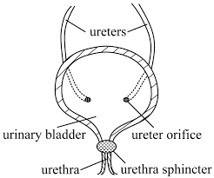
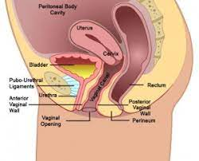
University of Basrah
Al-Zahraa Medical College
Ministry of higher Education and Scientific Research
Urinary bladder
It is a hollow organ that stores urine from the kidneys before disposal by urination. The bladder has an average capacity of 400 ml, but can retain as much as 3–4 liters of urine. The ureters open into the base of the bladder and the urethra leaves the bladder below the ureteric orifices. The base of the bladder is adjacent to the cervix, with only a thin layer of tissue intervening
Bladder injury may occur after abdominal or vaginal hysterectomy; caesarean section or after laparoscopic surgery. Most common site of injury is the apex of bladder. Untreated injury may result in vagino- vesical fistula.

Slide 20
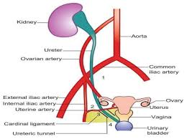
University of Basrah
Al-Zahraa Medical College
Ministry of higher Education and Scientific Research
Ureter
The ureters are a pair of tubes that carry urine away from the kidneys to the bladder. The adult ureter is a delicate structure, about the width of a pencil, and roughly 30 cm in length
The ureter is the retro-peritoneal structure , crosses the pelvic brim, it lies in front of the bifurcation of the common iliac artery. It runs downwards and forwards on the lateral wall of the pelvis to reach pelvic floor and then passes inwards and forwards attached to the peritoneum of the back of the broad ligament to pass beneath the uterine artery.

Slide 21
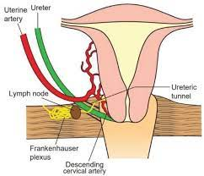
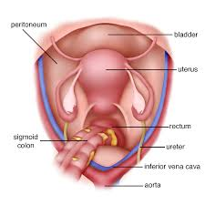
University of Basrah
Al-Zahraa Medical College
Ministry of higher Education and Scientific Research
Ureter
It next passes forward through a fibrous tunnel, the ureteric canal, in the upper part of the cardinal ligament.
Finally, it runs close to the lateral vaginal fornix to enter the trigone of the bladder.
The ureter may cut or tied or undergo necrosis during surgery leading to ureterovaginal fistula if not corrected.
Common site of ureteric injury
i) infundibulopelvic ligament;
(ii) by the side of the cervix (clamping the cardinal ligament along with descending cervical artery);
(iii) vaginal angle as the ureter traverses along the
anterior fornix;
(iv) during pelvic peritonization (ureter lies in the
posterior leaf of the peritoneum).

Slide 22
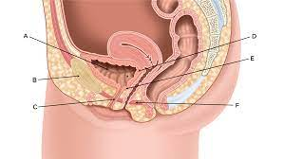
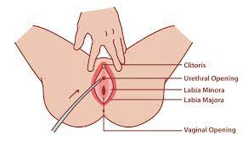
University of Basrah
Al-Zahraa Medical College
Ministry of higher Education and Scientific Research
The urethra
The urethra is a tube that connects the urinary bladder to the urinary meatus for the removal of urine. The female urethra is about 3.5 cm long

Slide 23
University of Basrah
Al-Zahraa Medical College
Ministry of higher Education and Scientific Research
Structural problems of pelvic organs
Müllerian anomalies
:O)ccurs in up to 6% of the female population.
The aetiology is unknown, previously we said due to intrauterine exposure to Diethyl-stilbesterol (DES) drug.
They are associated with renal anomalies in up to 30%.

Slide 24
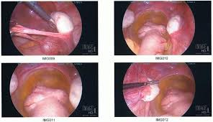
University of Basrah
Al-Zahraa Medical College
Ministry of higher Education and Scientific Research
Mullerian Agenesis
In approximately 1 in 5,000 to 1 in 40,000 girls, the Müllerian system does not develop, resulting in an absent or rudimentary uterus and upper vagina and fallopian tubes; but not the ovaries.
This condition is known as Rokitansky
The aetiology of this condition is not known, although possible factors include environmental, genetic, hormonal or receptor factors
On examination, the vagina will be blind ending and short. An ultrasound scan will confirm the presence of ovaries, but no uterus
Karyotype = 46 XX
Phenotype = Female

Slide 25
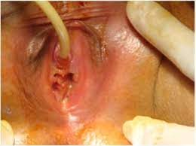
University of Basrah
Al-Zahraa Medical College
Ministry of higher Education and Scientific Research
Mullerian Agenesis
Presentations
Patient present between 15–18 years of age with primary amenorrhoea, Secondary sexual characteristics are normal as ovaries are normal
i.e. breast, pubic hair and axillary hair all are normal.
Vagina is felt like a blind pouch and uterus is absent
Differential Diagnosis
Cryptomenorrhea- Imperforate hymen
Testicular feminization syndrome
Management:
Vaginoplasty

Slide 26
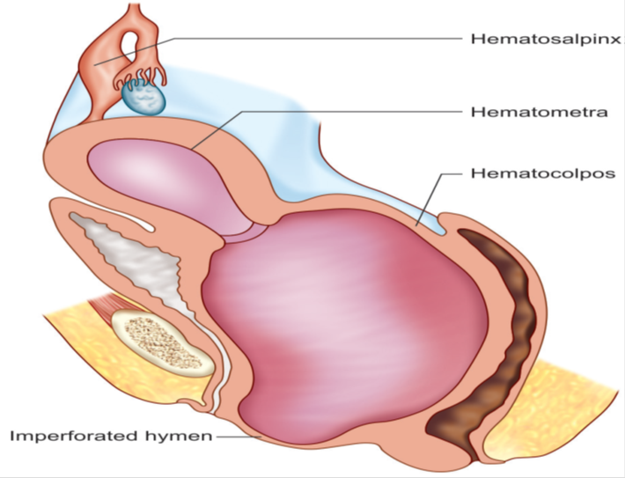
University of Basrah
Al-Zahraa Medical College
Ministry of higher Education and Scientific Research
Müllerian obstruction
Failure of complete canalization of the vagina can lead to menstrual obstruction (Cryptomenorrhea)
Type : lower down --- Imperforated hymen - obstruction at the level of hymen leading to collection of menstrual blood at each cycle in menarche age. Presented as primary amenorrhea with increasing abdominal pain, periodic in a girl in early adolescence and may presented with frequency, dysuria or even retention of urine. The cause of retention is
due to elongation of the urethra
Abdominal examination reveals a suprapubic swelling The retained menstrual blood stretches the vagina, causing a haematocolpus. This can cause a large pelvic mass and on vulval inspection, a tense bulging membrane of bluish coloration at the vaginal entrance.

Slide 27
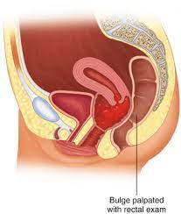
University of Basrah
Al-Zahraa Medical College
Ministry of higher Education and Scientific Research
Müllerian obstruction
Ultrasonography can make the diagnosis of hematometra and hematocolpos
Treatment:
Cruciate incision is made in the hymen. The quadrants of the hymen are partially excised
Vaginal transverse septum
It is a defect in the fusion and/or channelling of the urogenital sinus and Mullerian system . This structural obstruction can completely obstruct the vagina and thus can cause a primary amenorrhoea , haematocolpos associated with cyclic pelvic pain shortly after menarche in adolescent girls. The diagnosis of a vaginal septum is based on a careful clinical gynaecological examination and especially on ultrasound scan via the abdominal or transrectal and in more complex cases on MRI. The treatment is surgical and must be carried out as early as possible.

Slide 28
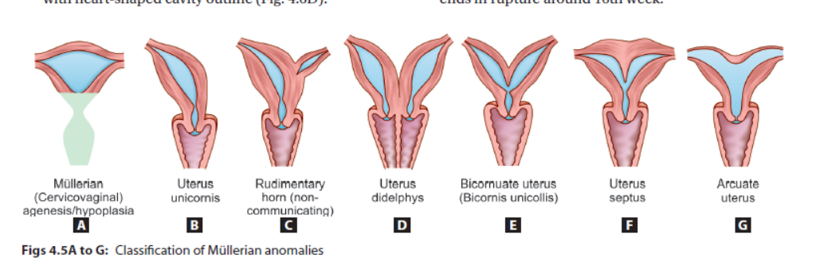
University of Basrah
Al-Zahraa Medical College
Ministry of higher Education and Scientific Research
UTERINE ANOMALIES
Incidence of Müllerian abnormalities varies between 3 and 4% and high in women suffering from recurrent miscarriage or preterm deliveries (5–20%).

Slide 29
University of Basrah
Al-Zahraa Medical College
Ministry of higher Education and Scientific Research
UTERINE ANOMALIES
Presentation: may be asymptomatic , or dyspareunia, infertility, dysmenorrhea, Menstrual disorders (menorrhagia, cryptomenorrhea) ; Midtrimester miscarriage which may be recurrent; corneal pregnancy;
Cervical incompetence. ; increased incidence of malpresentation ; Preterm labor, IUGR, IUD ;Prolonged labour Obstructed labour ;. Retained placenta and postpartum hemorrhage
Diagnosis
Internal examination
hysterography, hysteroscopy, laparoscopy,
Ultrasonography; magnetic resonance imaging (MRI)
Treatment:
Sometime No treatment needed
Hysteroscopic

